Slide 1

Inteligência Artificial

Slide 2
Modelo OAI-PMH – Phase I
Journal
Metadata Harvesting
Processing Metadados
Harveting PDF
Authority Control
Vocabulary Control
RDF Model

Slide 3
Modelo OAI-PMH – Phase II
Process PDF
Convert to TXT File
Process TXT File

Slide 4
Modelo OAI-PMH – Phase III – Identify Elements
TXT File
Identify Cited
Identity Submission Dates

Slide 5
Modelo OAI-PMH – Phase IV – Artificial Inteligence
TXT File
Separete in Phrases
Separate in Word
Remove Stop Words
Create a Semantic File

Slide 6
TextFile
Todas as letras em caixa baixa
Troca todos os caracteres especiais por padrão

Slide 7
Auxiliar Index

Slide 8

Domain
Áreas de Domínio

Slide 9
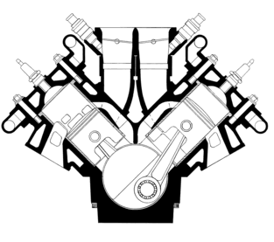
Engine

Slide 10
Dentro do corpus
Identificar frases

Slide 11

Chatbots

